Slide 1
Radio Frequency Camera Assisted Rover (RFCAR)
José Pires a50178
Hugo Carvalho a85156
Hugo Ferreira a80665
João Faria a85632
João Carvalho a83564
José Mendes a85951
Nuno Rodrigues a85207
Laboratório e Práticas Integradas II 2019/20 Tutor: Professor Doutor Vítor Silva

Slide 2
Outline
Introduction
Requirements Elicitation and Specifications Definition
Analysis
Design
Implementation
Testing: Unit and Integrated
Verification & Validation
Conclusions
Future Works
Extras
References

Slide 3
Introduction: Motivation & Goals
The main goal of the project is to develop a remote controlled vehicle with the following characteristics:
Remotely operated
Provide visual feedback to the user
Safe
Robust
Affordable

Slide 4
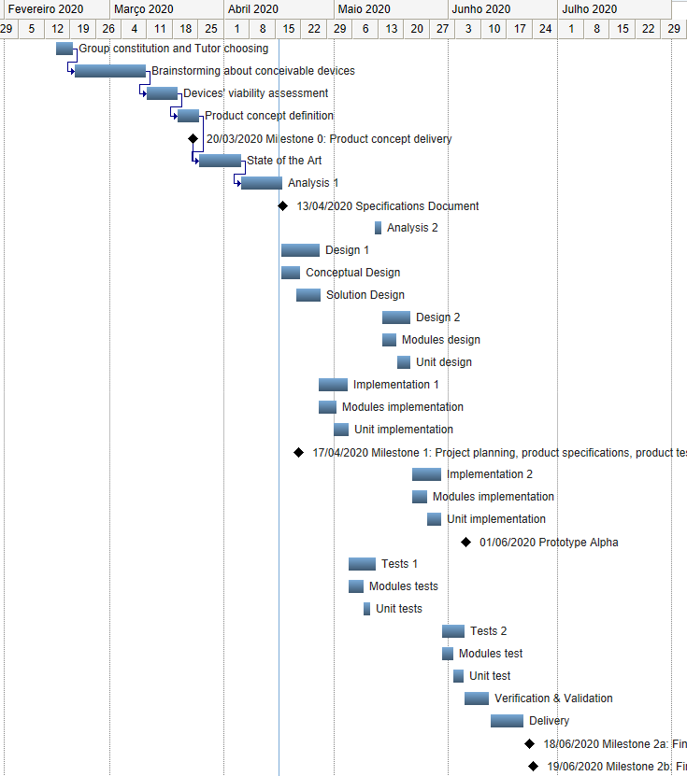
Introduction: Initial Planning

Slide 5
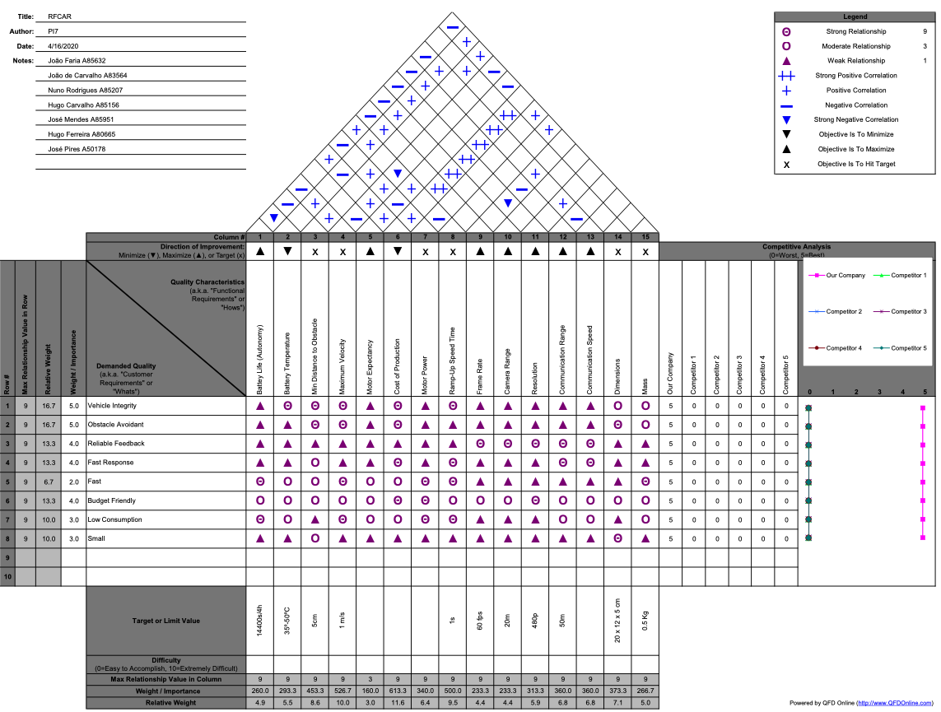
Requirements Elicitation & Specs Def

Slide 6
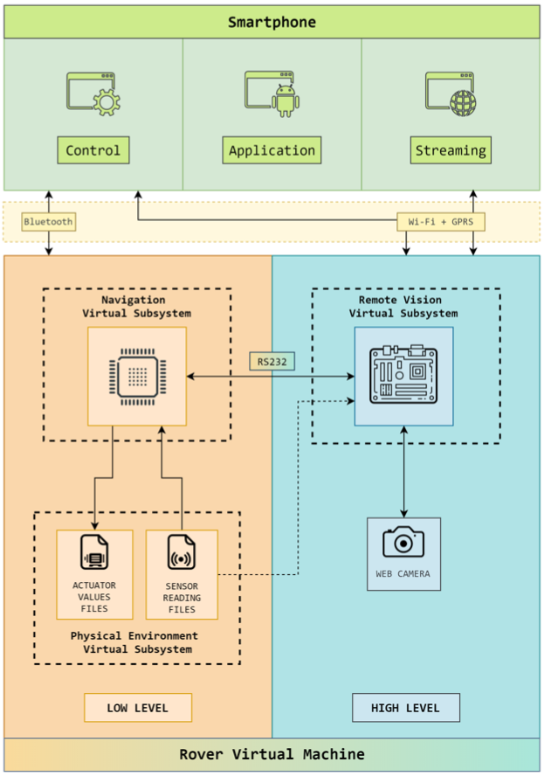
Analysis: Initial design

Slide 7
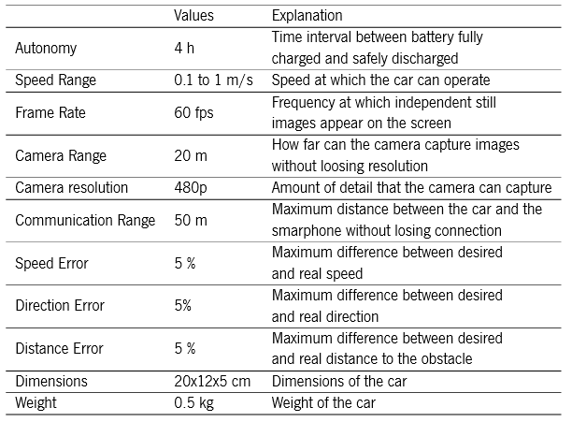
Analysis: Foreseen Specifications

Slide 8
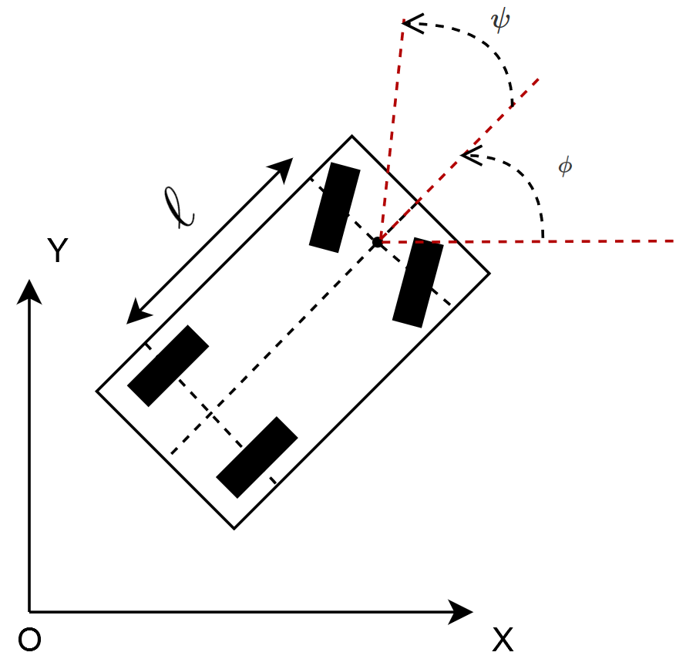

Design: Vehicle model

Slide 9
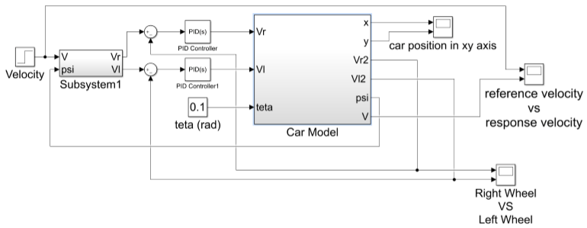
Design: Control

Slide 10
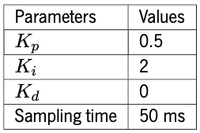
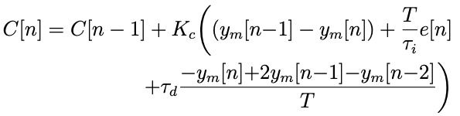
Design: Digital Control
Discrete PID: modified speed
Parameters

Slide 11
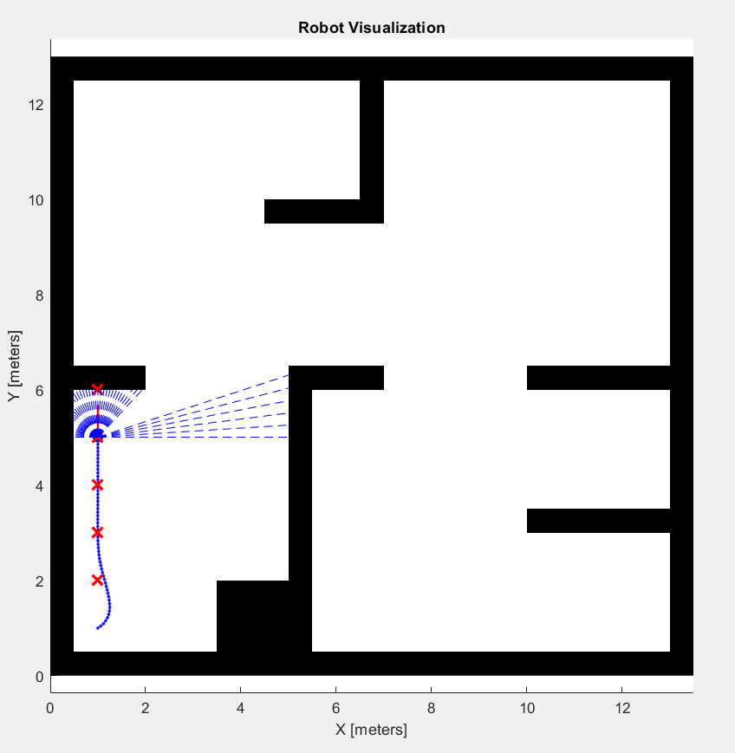
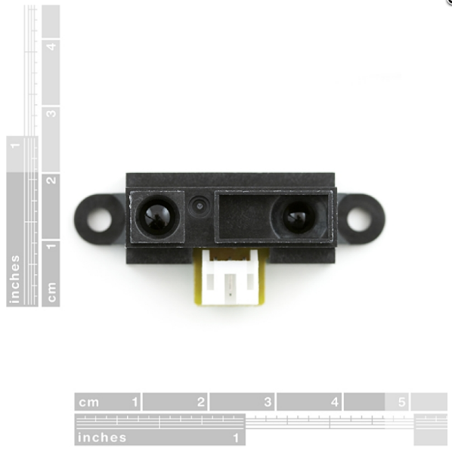
Design: Obstacle Avoidance
Simulation
Odometric sensors

Slide 12
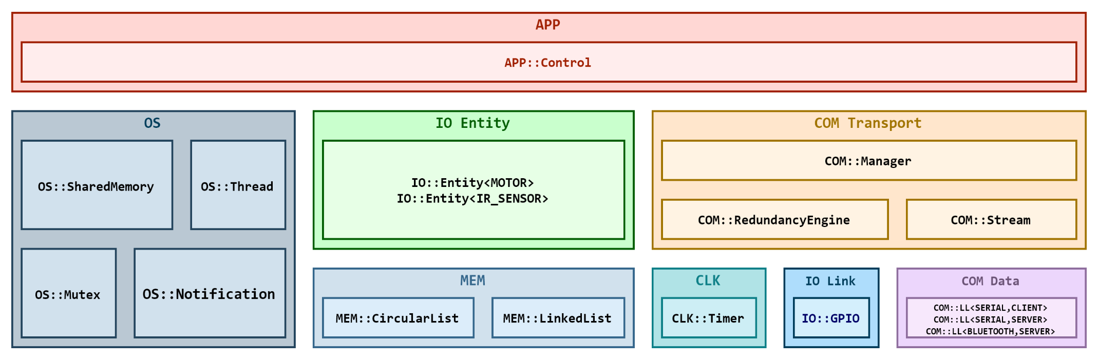
Design: Navigation
System design: Full stack

Slide 13
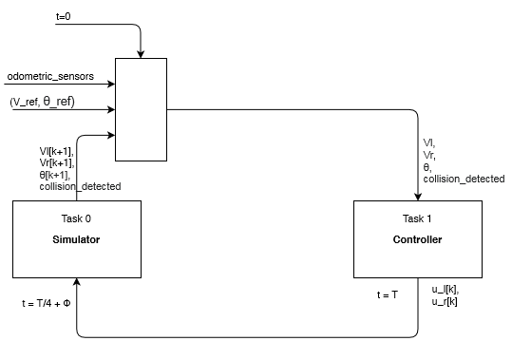
Design: Physical Environment Virtual Subsyst

Slide 14
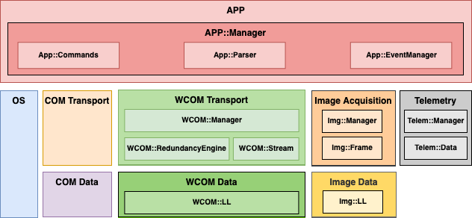
Design: Remote Vision
System design: Full stack

Slide 15
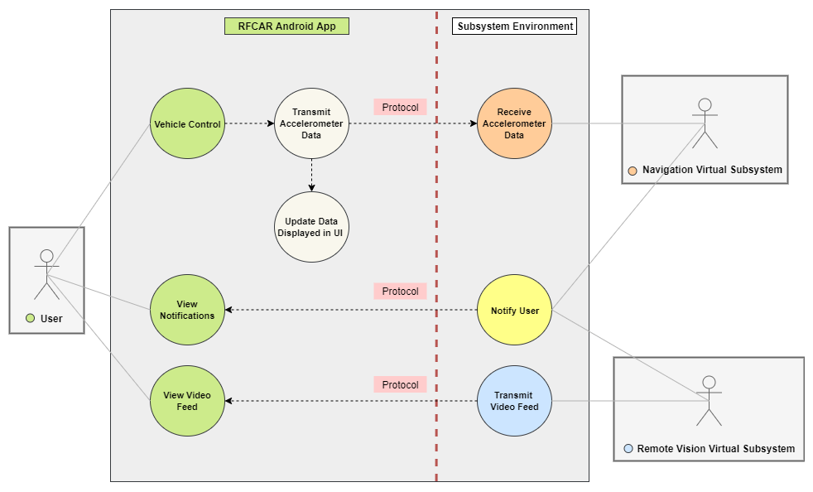
Design: Smartphone

Slide 16
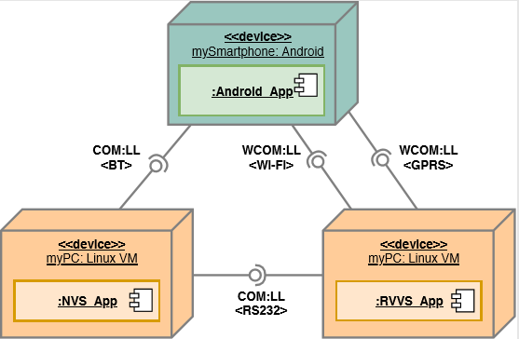
Design: Hardware/Software mapping
Deployment diagram

Slide 17
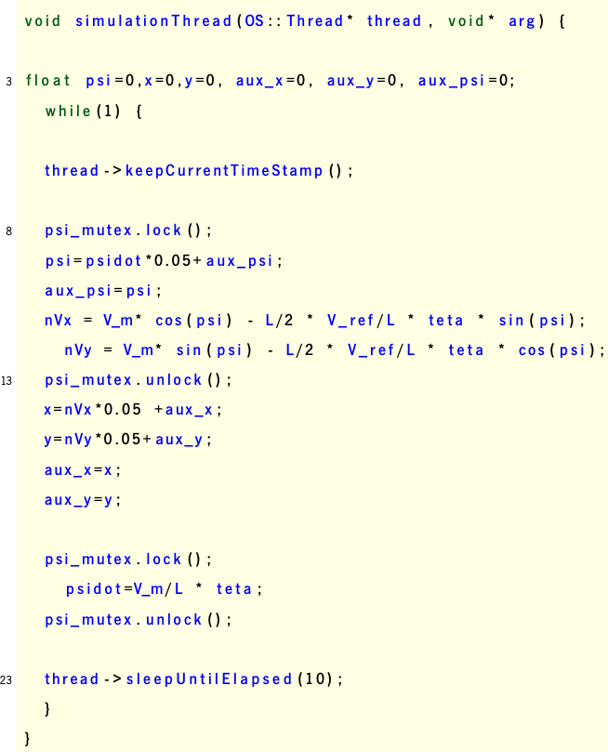
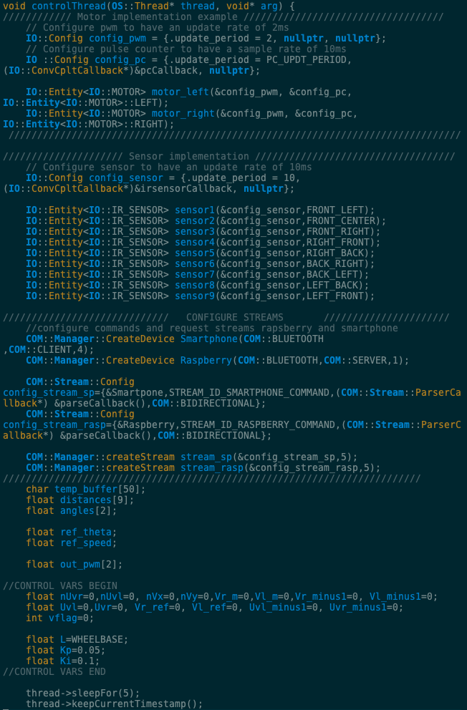
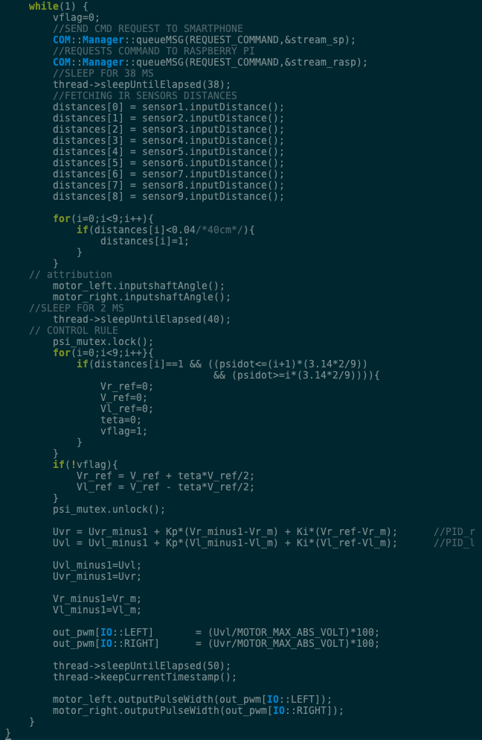
Implementation: Navigation
Simulator Thread
Controller Thread

Slide 18
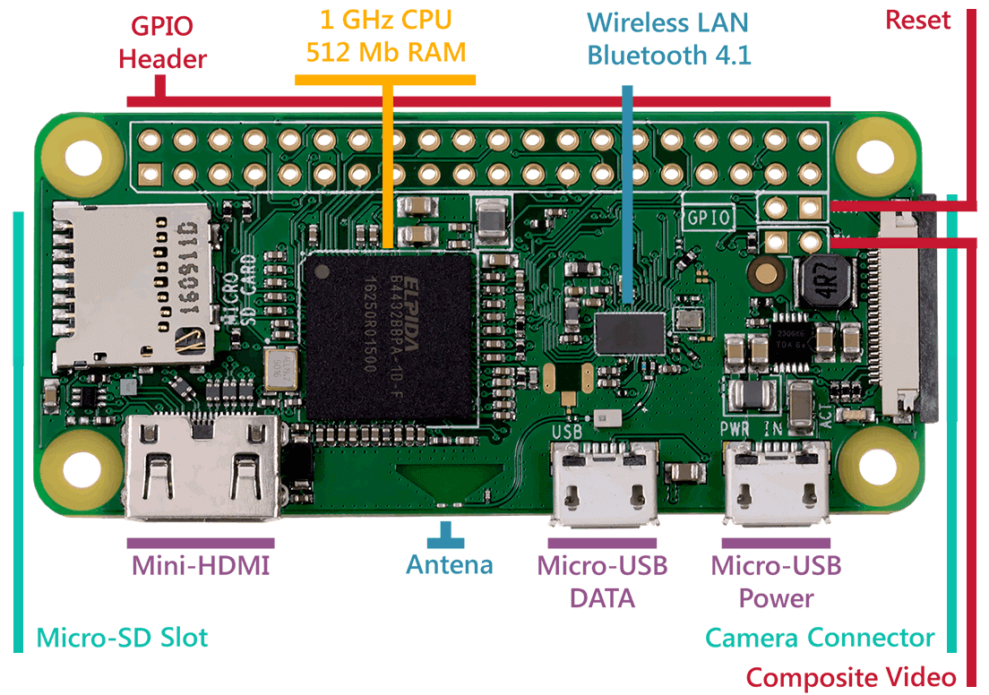
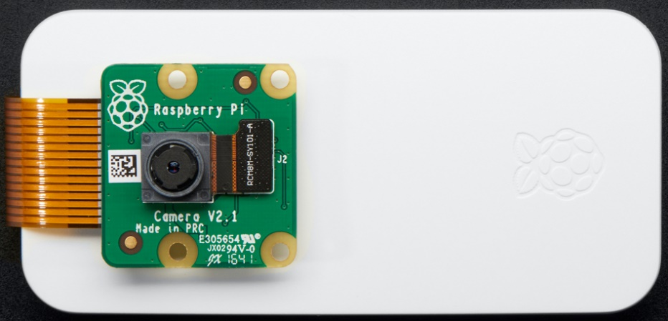
Implementation: Remote Vision
Hardware: Envisioned
Raspberry Pi W Zero: 5 €
Camera: 20-35 € - 5-12 Mega px

Slide 19
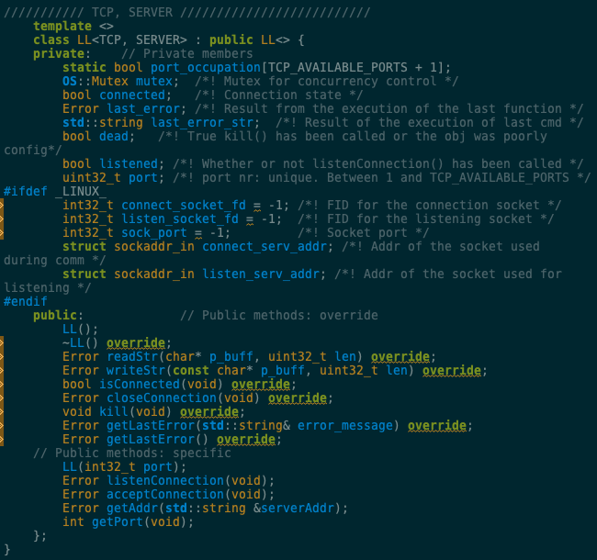
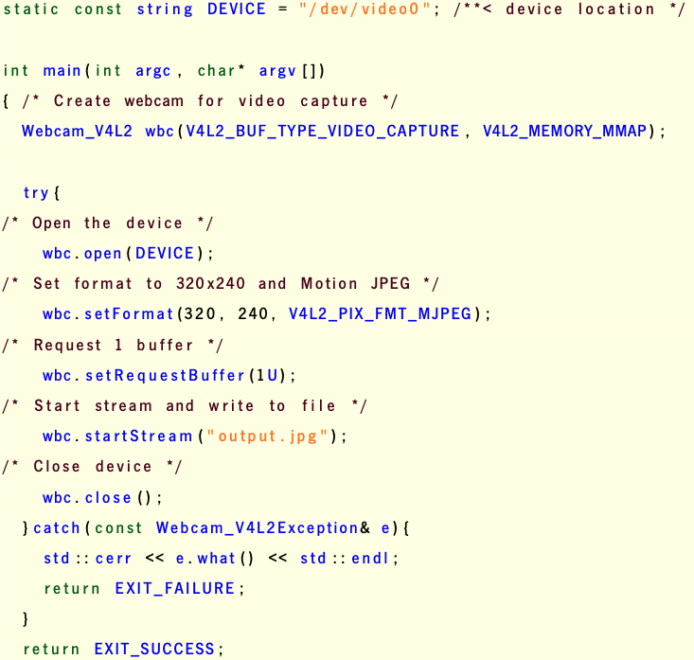
Implementation: Remote Vision
Software
Webcam
Wi-Fi (Client/Server)

Slide 20
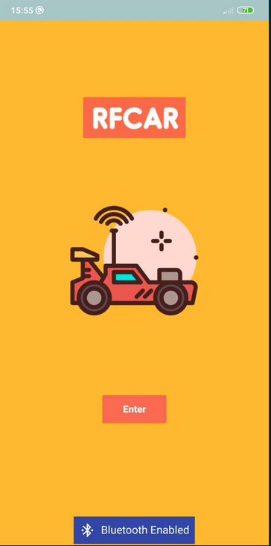

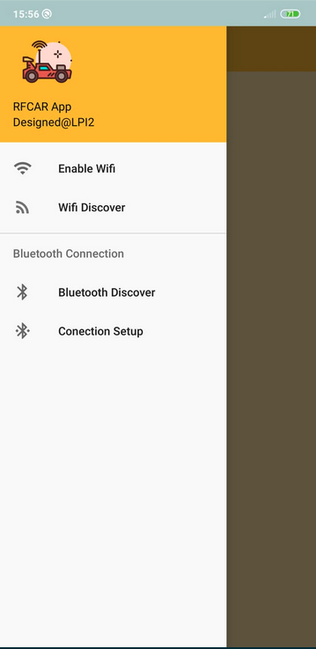
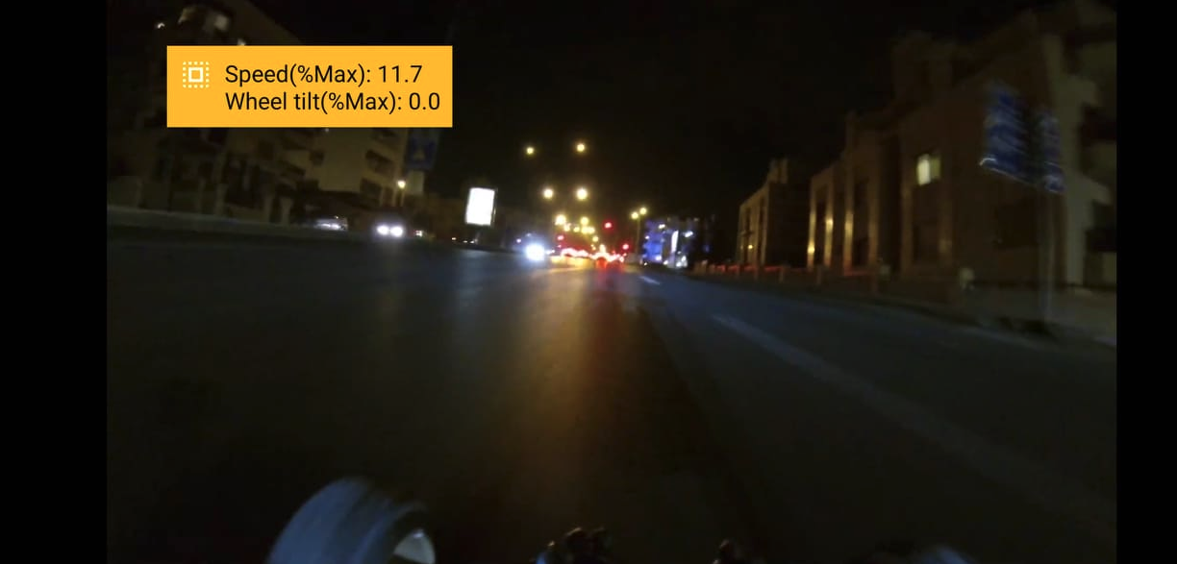
Implementation: Smartphone
UI

Slide 21
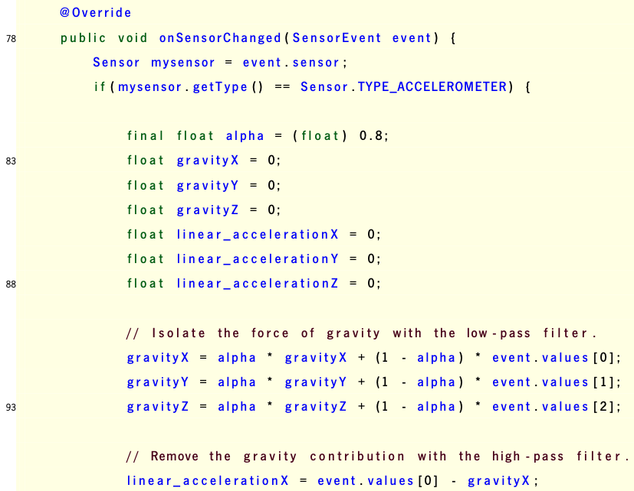
Implementation: Smartphone
SW: sensor interaction

Slide 22
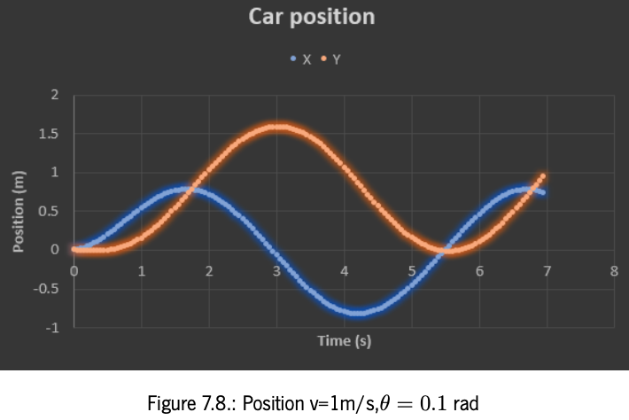
Unit testing: Navigation
Control

Slide 23
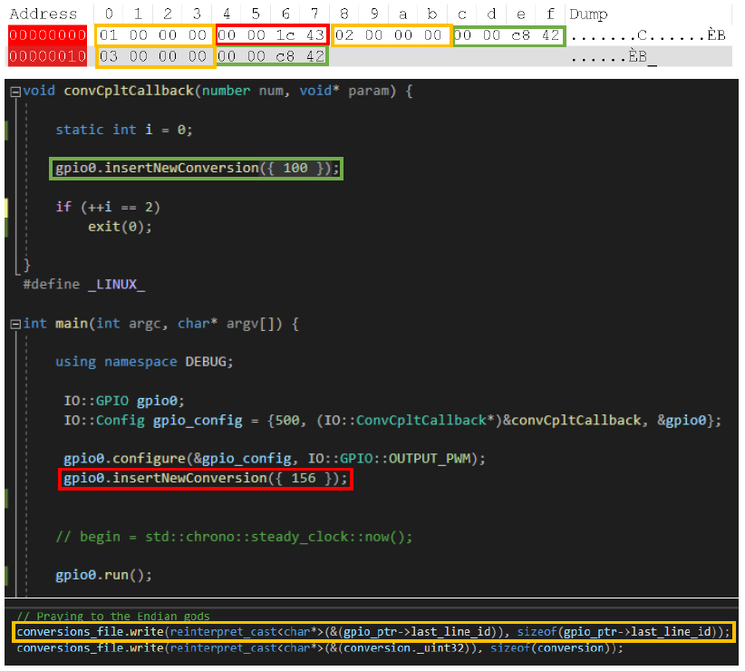
Unit testing: Navigation
IO: PWM output tests

Slide 24
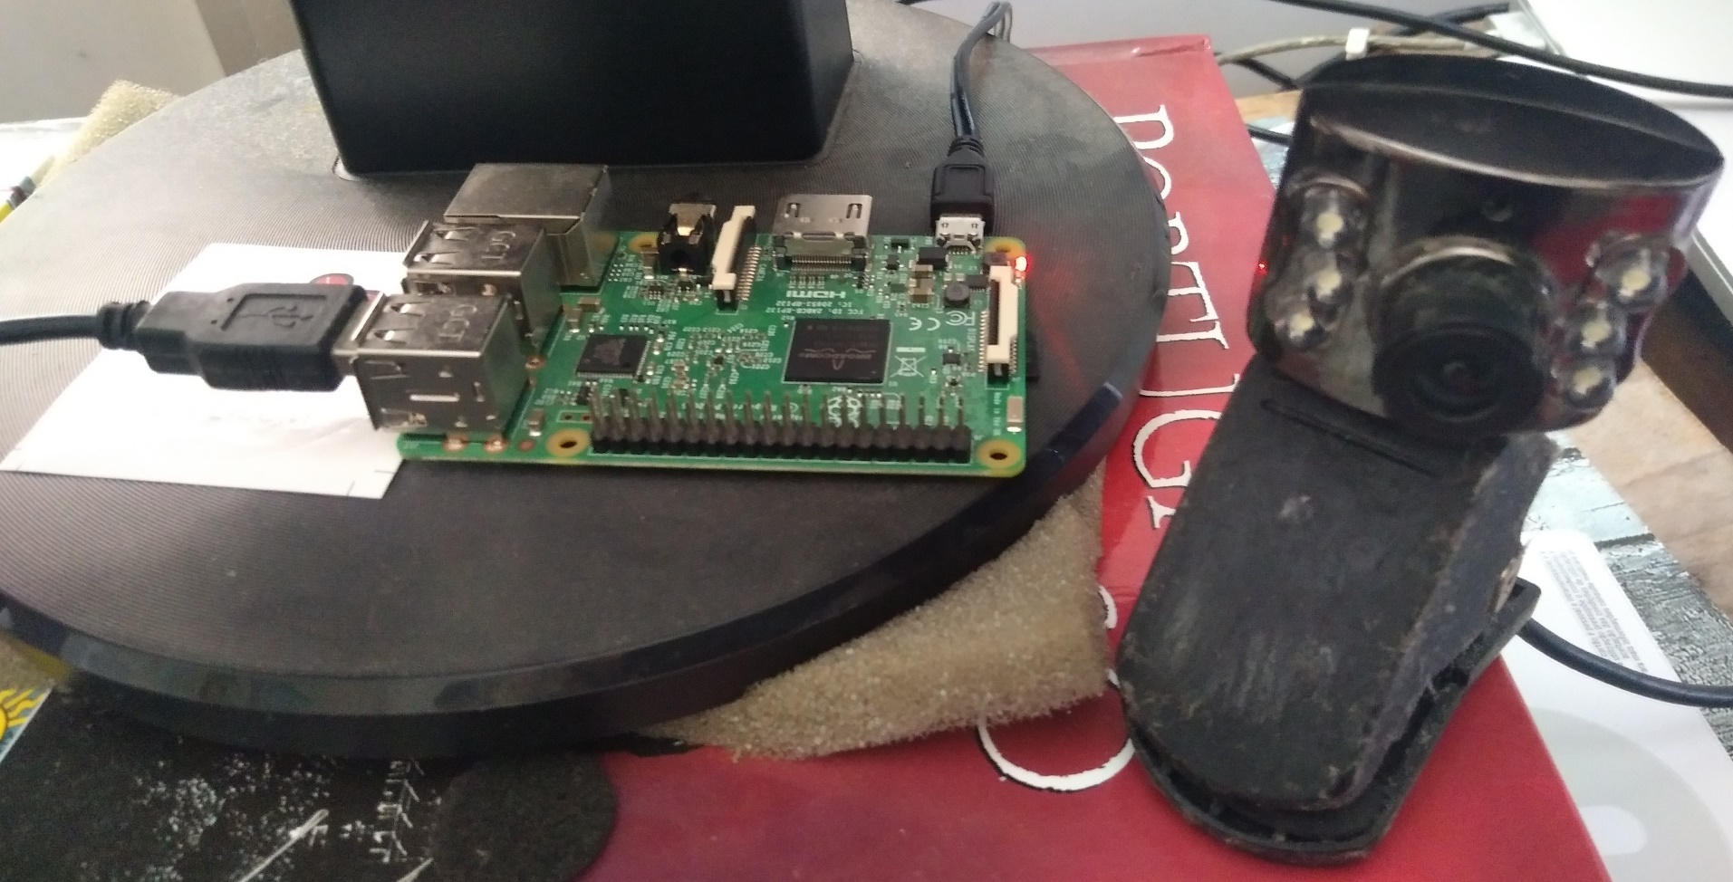

Unit testing: Remote Vision
Webcam
Setup
Image capture

Slide 25
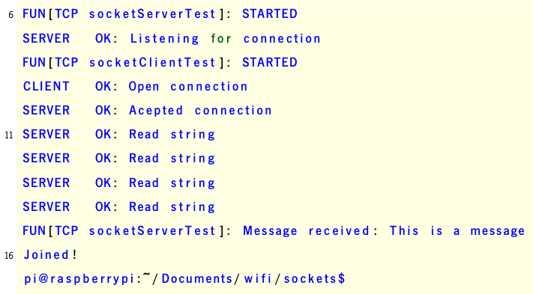
Unit testing: Remote Vision
Wi-Fi
Setup
Wi-Fi Client/Server Tests: Success

Slide 26
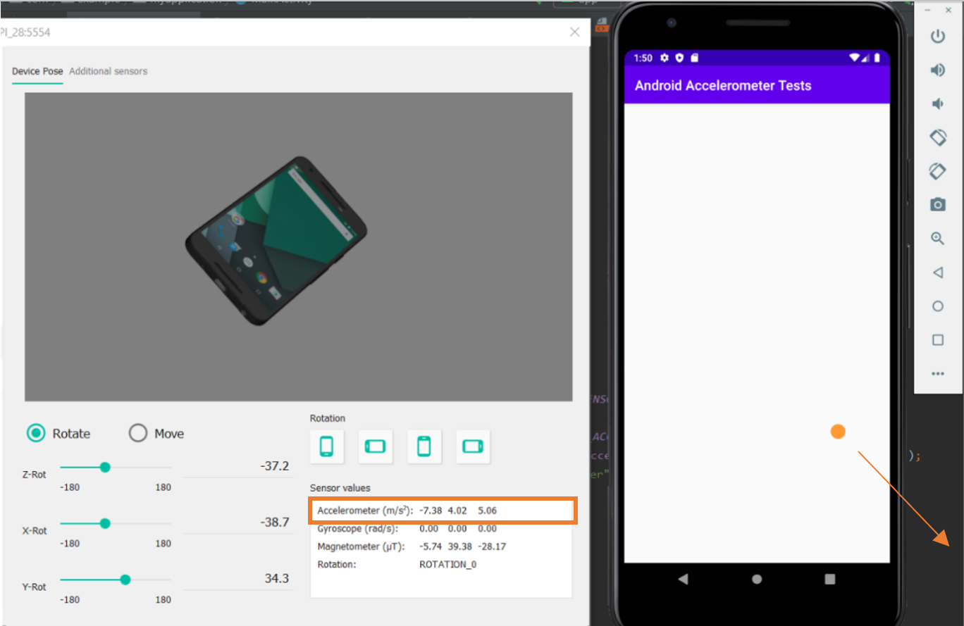
Unit testing: Smartphone
Accelerometer

Slide 27
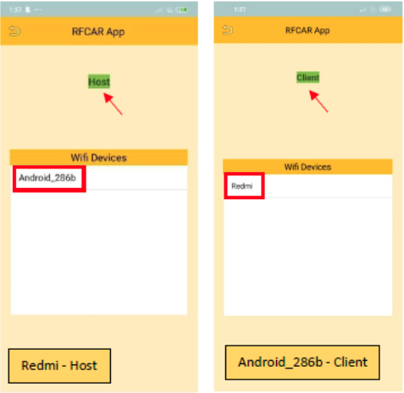
Unit testing: Smartphone
Wi-Fi

Slide 28
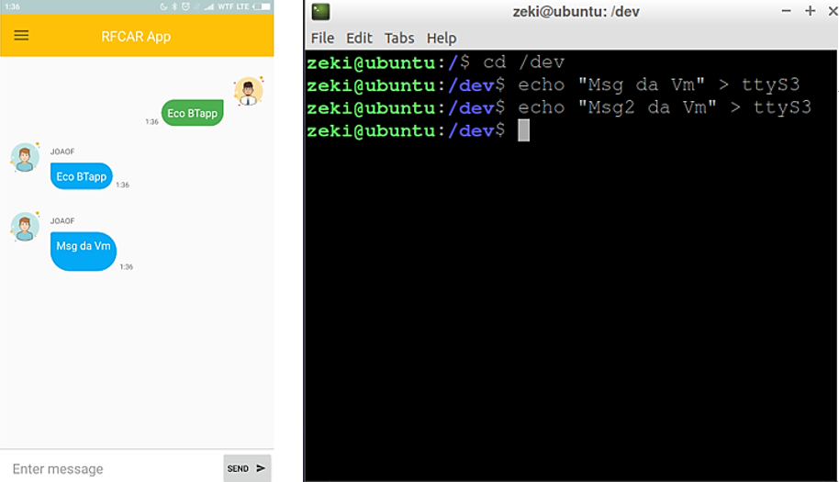
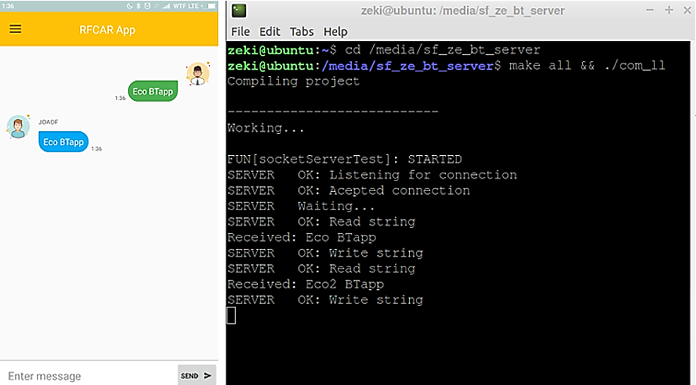
Integrated testing: Smartphone & NVS
Reception
Echo

Slide 29
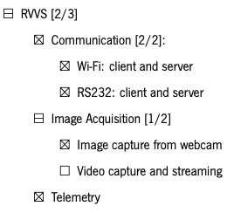
Functionalities: Summary

Slide 30
Verification: Control algorithms correctness

Slide 31
Verification: Image Acquisition
Only uyvy422 format is supported
Packed format, which hinders streaming
MJPEG would be a better option
Framerate: 30 fps (only)
Resolutions: 640x320, 352x288, 340x240, 176x144, 160x120
Only image acquisition was possible

Slide 32
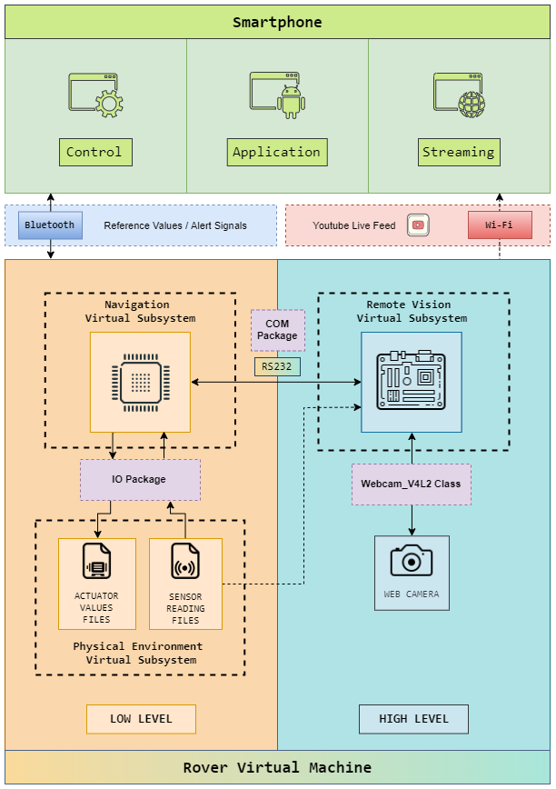
Verification: Functionality & Communications

Slide 33
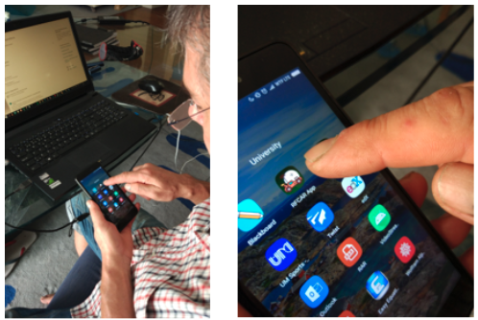
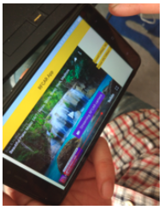
Validation

Slide 34
Conclusions
Waterfall methodology
Model-based design and simulation
Restrictions:
Time window
Virtualized environment
Results: were the expected, although:
the specifications could not be complied fully

Slide 35
Conclusions
Verdict: Success
Full-stack development for Navigation and Remote Visions subsystems with HW abstraction
Vehicle control and obstacle avoidance
Communications interfaces: Bluetooth, RS232, Wi-Fi
Image acquisition
UI with skeuomorphism, for intuitive vehicle navigation

Slide 36
Future Work
Prototype manufacturing
Communications redundancy setup
Video streaming tweaking
GPRS tracking
Obstacle avoidance strategy upgrade
Real world testing

Slide 37
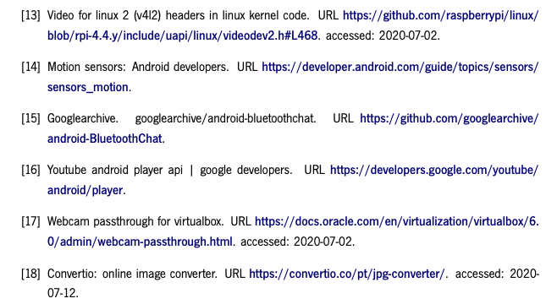
References

Slide 38
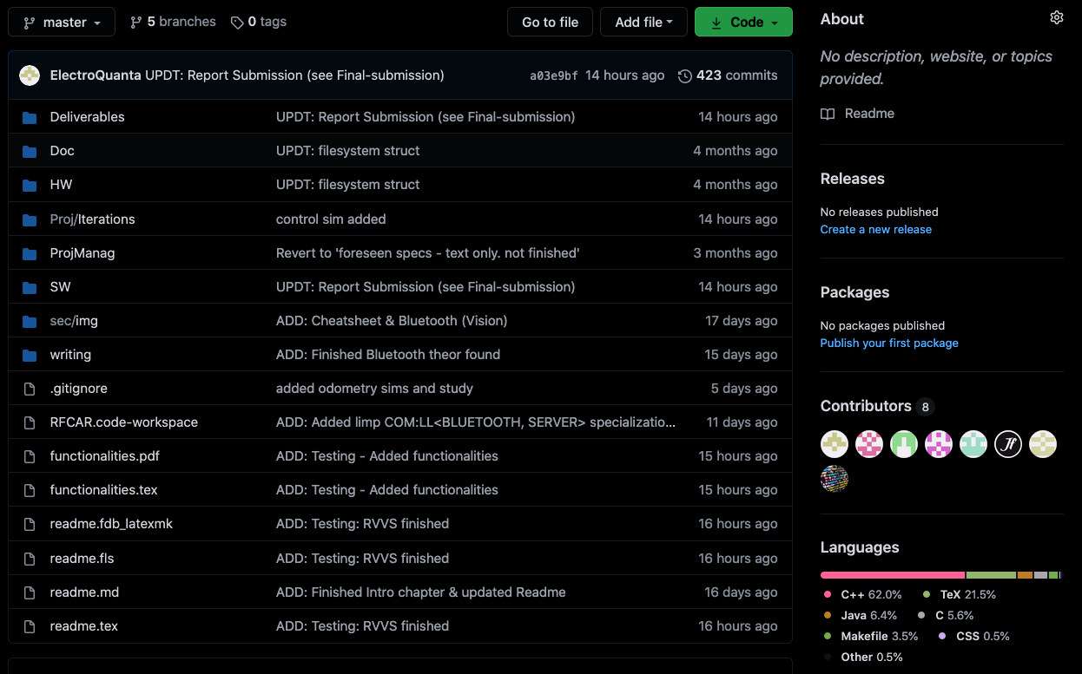
Extras: Online Repository

Slide 39
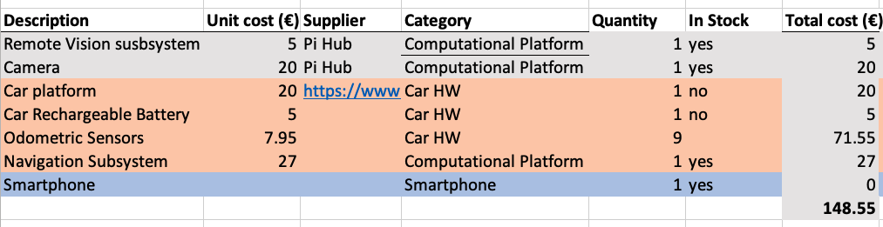
Extras: Project Management
Manpower: 250h/team member
Acquisition Costs
Development Costs: 10 €/h
Breakeven (1000 units): 250 €

Slide 40
Thank you for your attention

Slide 41
Extras: Demonstration

